Slide 1
Audio Key Detection/Estimation
Mirex Presentation for Computational Musicology: MSP
at Brooklyn College with Prof. Johanna Devaney
Nov. 20th 2018
by Jakob Georg Ruderer

Slide 2
What is Audio Key Estimation:
Key Estimation is classic task in music information retrieval
To determine the key of a Western piece is a fundamental requirement for tonal analysis
The goal is to identify the key of piece just from the audio (only the global key, without key changes due to modulations)

Slide 3
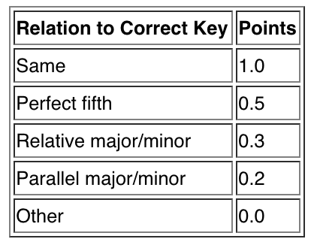
Evaluation

Slide 4
Datasets used for the Task
MIREX2005Key: 1,252 classical music audio pieces, as MIDI files using TiMidity Synthesizer (first 30 seconds only, due to potential key modulations after this point), used for the 2018:Audio Key Detection
In 2017 new datasets were included:
PresegmentedKeyIsophonics (with key annotations from Isophonics set)
PresegmentedKeyRobbieWilliams (with key annotation from Robbie Williams set)
Segments annotated with major and minor were submitted
Billboard2012Key, subset of Billboard2012 chord dataset, which made it possible to derive the key automatically from the chord annotations

Slide 5
Approaches to the Task I
2017 Katy Noland, Chris Cannam: QM Key Detector Plugin
QM Key Detector Plugin* is a vamp plugin estimates key of music by comparing the degree to which a block-by-block chromagram correlates to stored profiles for each major and minor key which come from analyses of J.S.Bach’s WTC Book I, recorded in equal temperament with A=440
Accuracy: Highest score out of all other in MIREX2005Key set with 88.07/100 (2017), significantly lower in all others
*by Katy Noland and Christian Landone

Slide 6
Approaches to the Task II
2017 Hendrik Schreiber: end-to-end machine learning
Magnitude spectrogram down sampling the signal and resampling the frequency axis to a logarithmic scale with resolution of 3 bins/semitone
oversampling for tuning corrections and it helps differentiate neighboring harmonic peaks (usually at least two)
Roughly two minutes of audio per sample
The network consists of 9 zero-padded convolutional layers with 8 filters each, those layers are followed by two other layers, one of them in the size of 24, representing 12 minor and 12 major keys (proposed network consists of 259,752 model parameters)

Slide 7

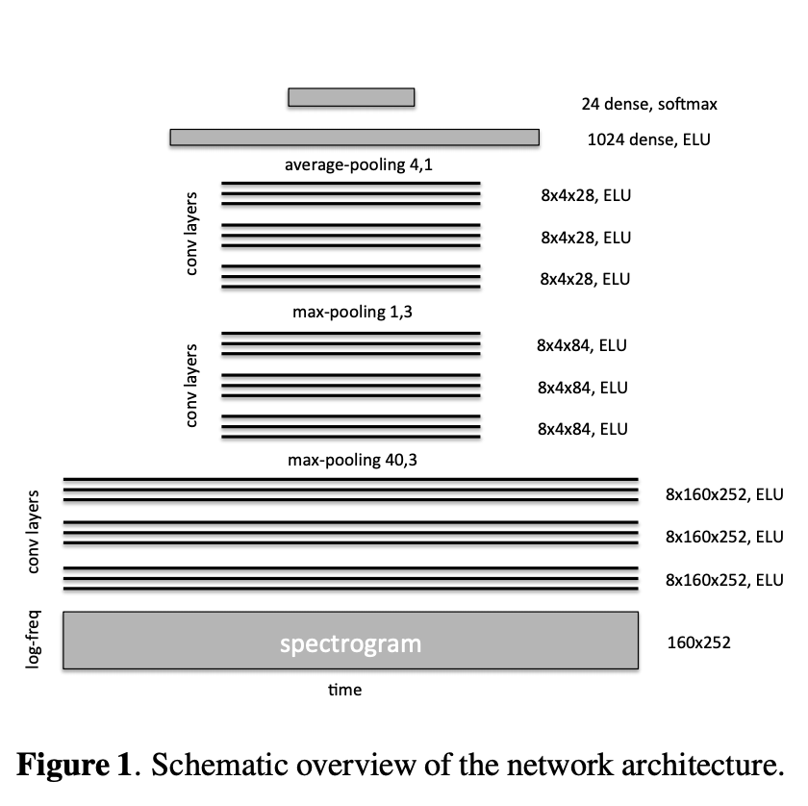



Hendrik Schreiber’s schematic overview of the network with its 11 layers
Key does not change rapidly ->

Slide 8
Training Datasets:
Three different trainings for separate submissions
The HS2 submission was trained with the Lakh MIDI Set (LMD), extracting key change events, matching the tracks to the Million Dollar Dataset genre annotations (almost 70% of a dataset of the size of 6,981), including rock, pop, country, R&B, classical, jazz and electronica
Accuracy results show that training datasets determine the score more than the overall approach since the submissions’ results in each test set vary significantly. HS2 has the highest score of all in the Billboard2012Key test set with 82.33/100 because it was trained on LMD only, validating the approach of extracting training data from LMD, which also suggests to have similarities with the Billboard2012Key dataset

Slide 9
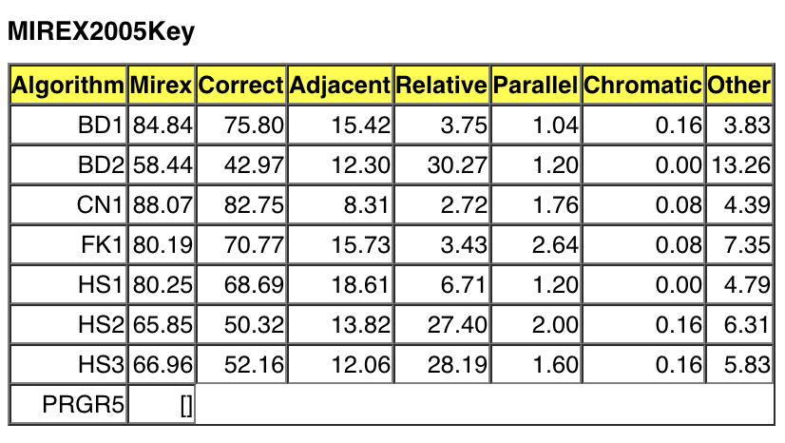
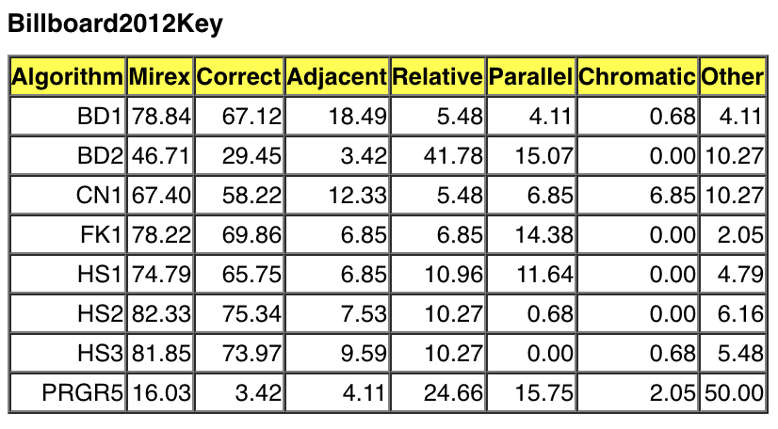
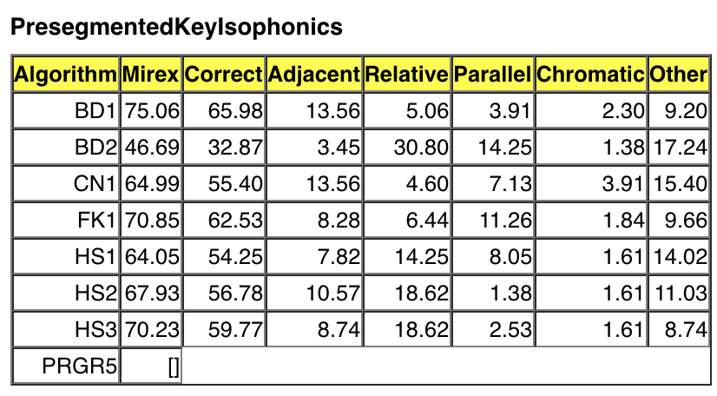
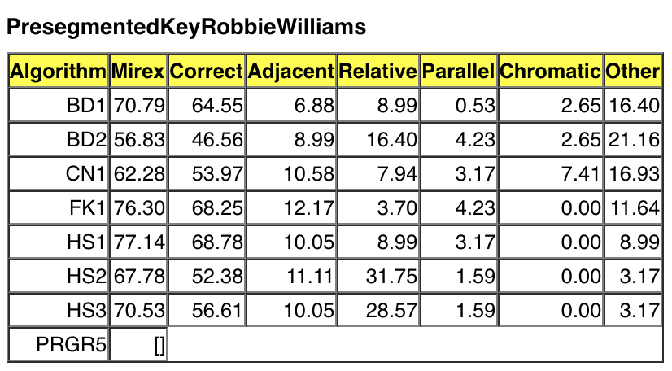
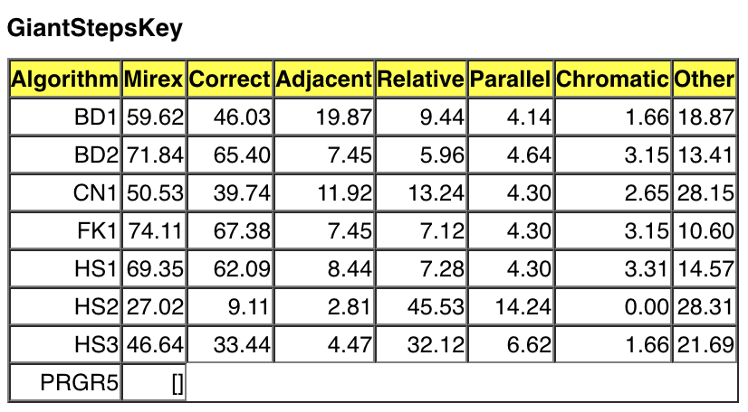
Overall results from 2017

Slide 10
Links to sSources for this presentation:
MIREX 2018:Audio Key Detection
https://www.music-ir.org/mirex/wiki/2018:Audio_Key_Detection
(last accessed Nov.20 2018)
Mirex 2017:Audio Key Detection Results
https://www.music-ir.org/mirex/wiki/2017:Audio_Key_Detection_Results
(last accessed Nov.20 2018)
Katy Noland’s and Chris Cannam’s 2017 submission:
https://www.music-ir.org/mirex/abstracts/2017/CN1.pdf
(last accessed Nov.20 2018)
Hendrik Schreiber’s 2017 submissions:
https://www.music-ir.org/mirex/abstracts/2017/HS1.pdf
(last accessed Nov.20 2018)

